Slide 1
Class Diagrams

Slide 2
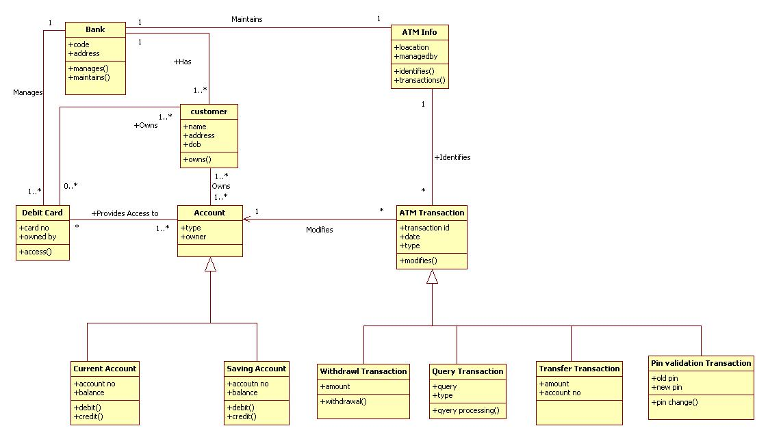
ATM

Slide 3
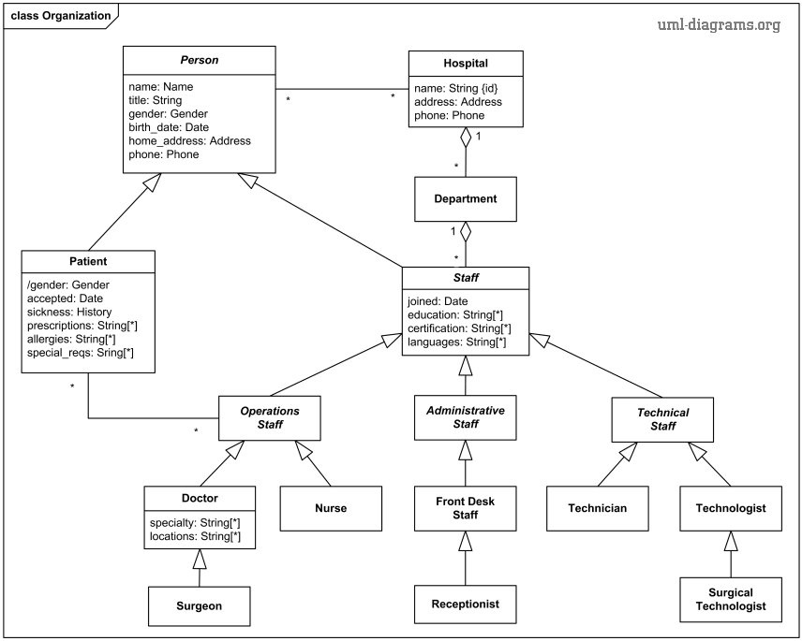
Hospital Mgmt Sys

Slide 4
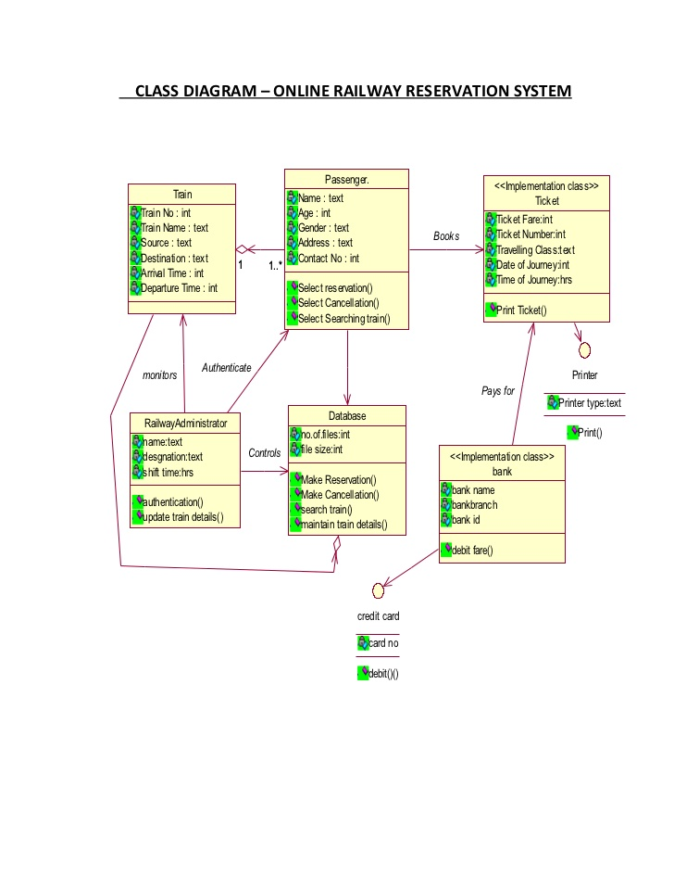
Railway Reservation Sys

Slide 5
Online BookShop

Slide 6
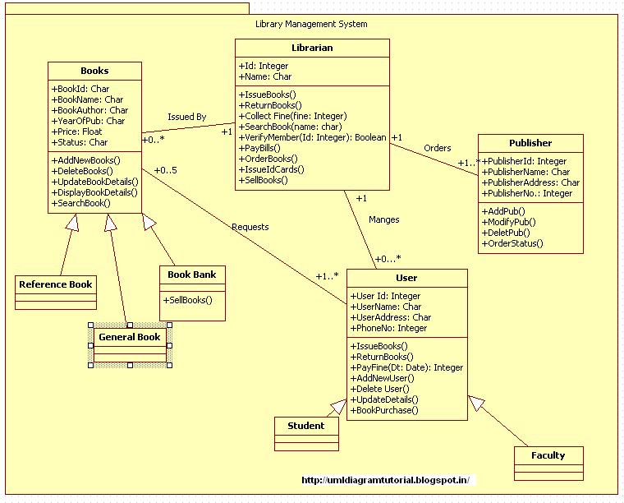
Library Mgmt Sys

